Slide 1
THE
ICE CREAM TRUCK
PROBLEM

Slide 2
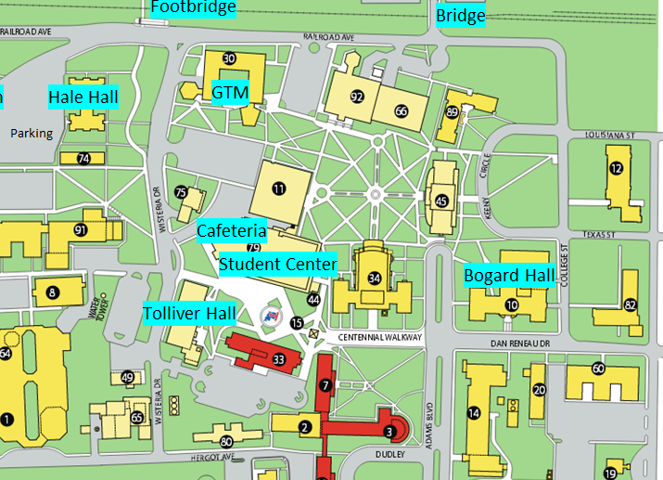
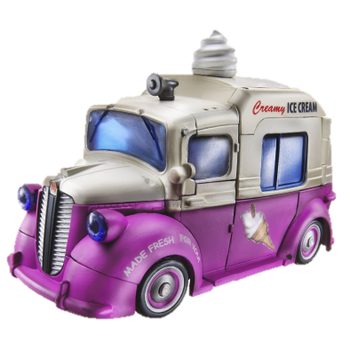


Slide 3
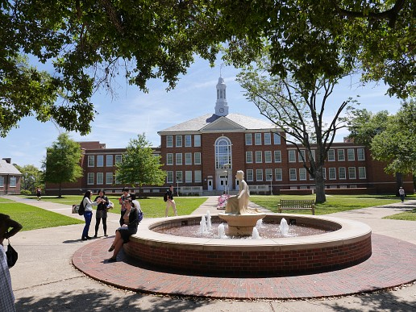

Slide 4
SECRET CODE:
43
59
42
45
52

Slide 5
CYBER

Slide 7
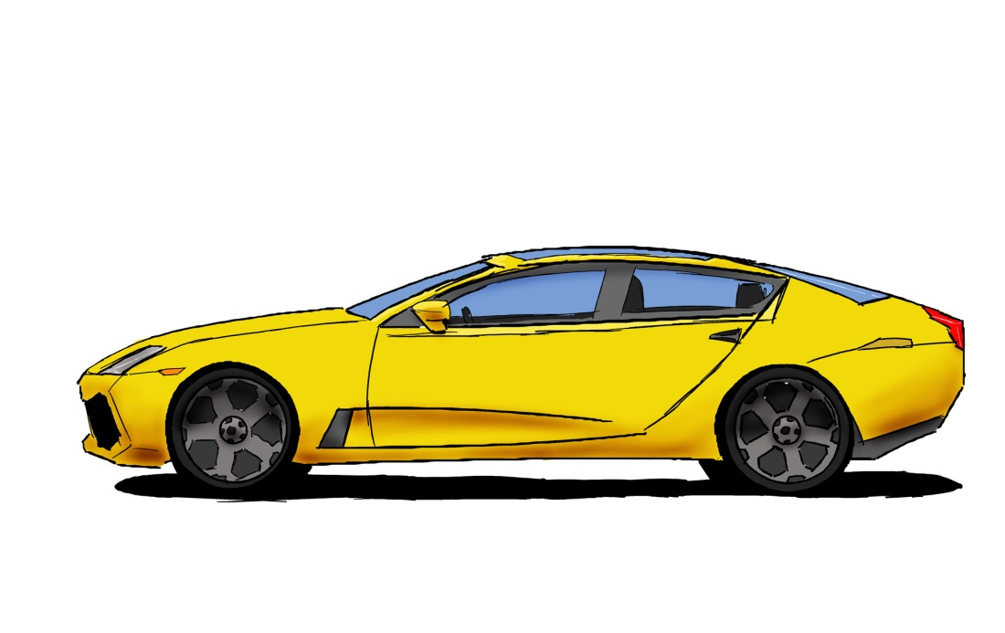
ONE SHORT CAR RIDE LATER

Slide 8
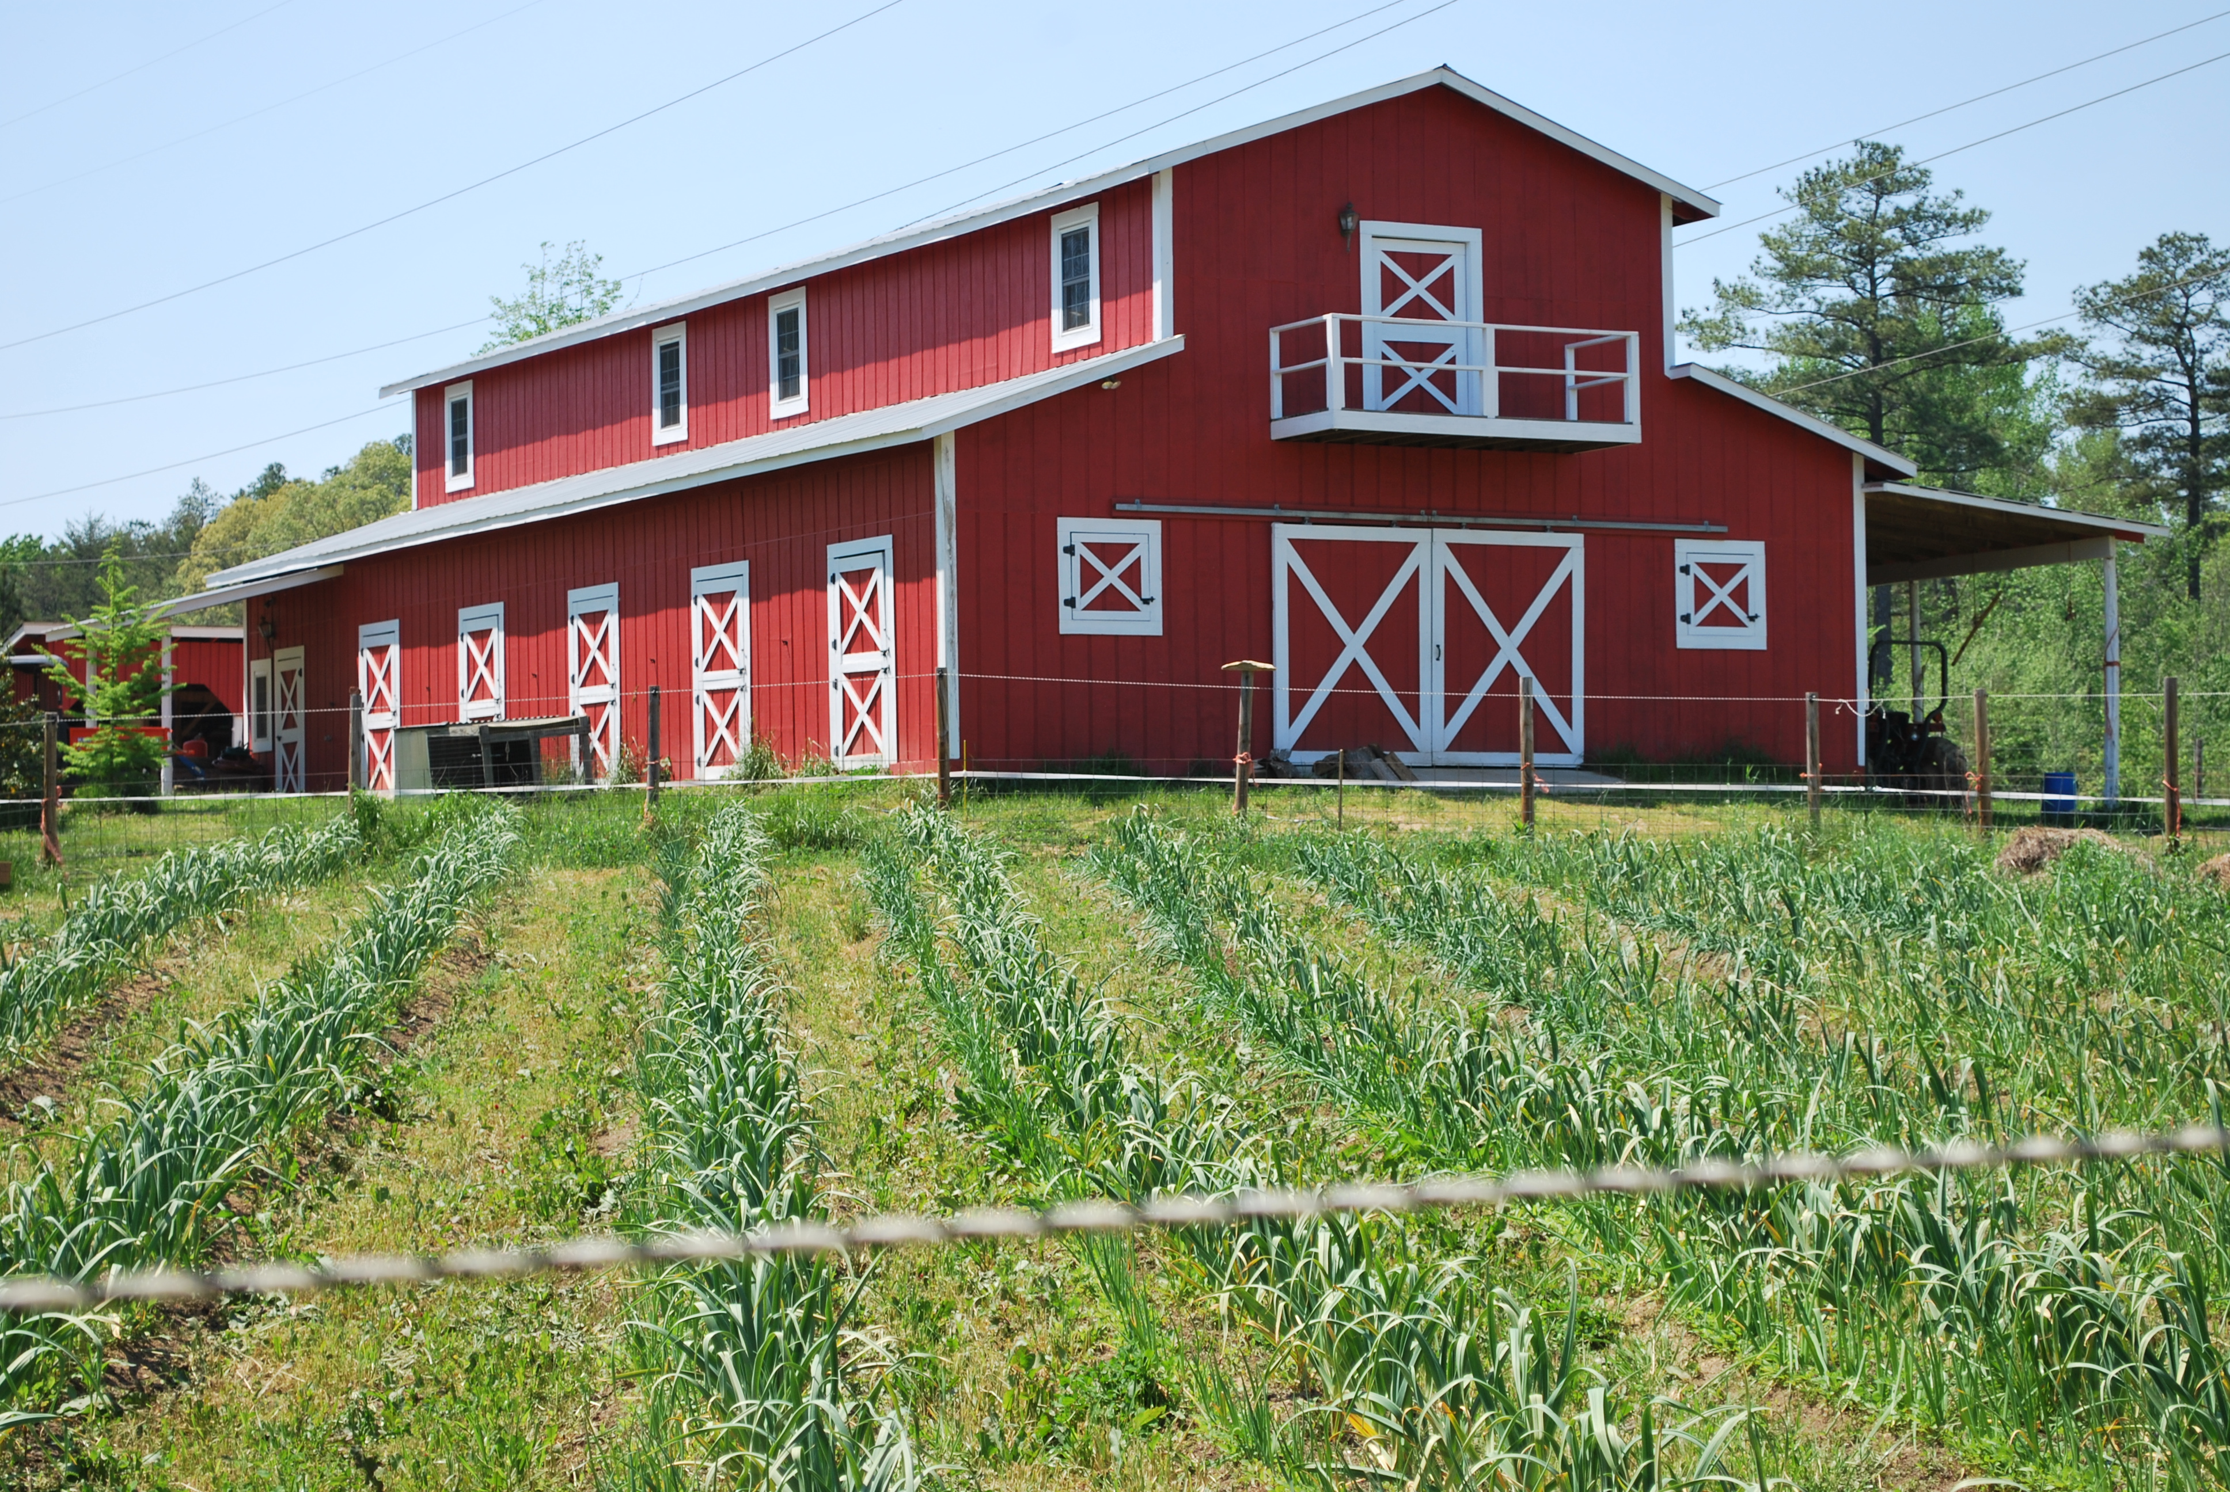

Slide 9
BACK TO THE PARK

